Slide 1
APRS Tracker PDR Max Bezold December 6, 2011
12/6/2011
Max Bezold
1

Slide 2
Requirements
Module shall transmit accurate GPS coordinates for the duration of the balloon flight.
Module shall log GPS coordinates.
Module shall be easily configurable on launch day.
Module shall be expandable to be used as a general purpose data logger.
Derived Requirements:
GPS shall be operable above 60,000 ft.
Module shall be robust to survive fall, water landing.
Battery life shall be >5hours
No more than 4 checklist steps required prior to launch.
Module shall have SMA connectors for radio to allow interchangeable antennas.
12/6/2011
Max Bezold
<number>

Slide 3
Eliminating launch preparation overhead
Having reliable built hardware greatly reduces the overhead of balloon missions.
-Sitting on a shelf, fully configured, tested, and ready to fly.
Providing header ports to microprocessor pins allows unit to be used as a multi-purpose data logger module/sensing platform.
Note: one unit should always be configured strictly as a tracking module, without any additional code.
12/6/2011
Max Bezold
<number>

Slide 4
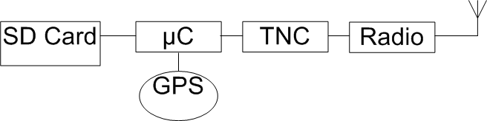
Basic Architecture
Brief Explanation:
GPS serial data sent to microcontroller.
Microcontroller saves this data onto an SD card via FAT-FS, and passes it to the TNC.
TNC creates a digital APRS packet with appropriate call sign and fields, and then converts this to an AFSK AX.25 audio signal that it passes to the radio.
The radio then transmits this on the standard APRS frequency (144.39 MHz)
12/6/2011
Max Bezold
<number>

Slide 5
A few points on high level architecture:
Modification 1: If we use a handheld radio with a built in TNC, we don’t have to procure a separate TNC. -We simply have the microcontroller send the radio serial commands. Kenwood TH-D7 handheld has this capability.
Modification 2: Another option involves adding TNC software to the microcontroller chip. Source code is available to do this.
12/6/2011
Max Bezold
<number>

Slide 6
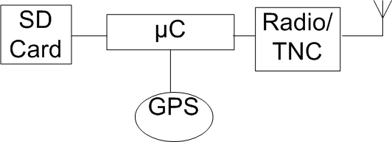
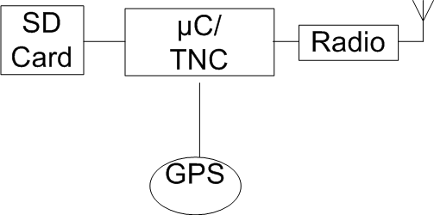
High Level Architecture Modifications
Modification 1: Use TNC onboard radio.
Modification 2: Implement code on microcontroller to send packets.
12/6/2011
Max Bezold
<number>

Slide 7
Components to Procure
Microcontroller
Radio
GPS Module
TNC
Note: only components with a known supplier featured in this presentation
12/6/2011
Max Bezold
<number>

Slide 8
Radios
 | SRB MHX-146 | Radiometrix Hx-1 | Kenwood TH-D7 | Friendcomm FC-301/D
Package description | Small PCB with headers | Aluminum box, solder mount to PCB | Self-contained, handheld unit | Aluminum box
Supply Power | 5V, 140mA transmitt | 5V, 5mA nominal, 350mA transient | 9.6V | 9-15V, 40mA nominal, 1.1A transient
Transmit Power | 350-500mW | 300mW | 5 Watts | 1-5 Watts
Frequency Agile | Y | N | Y | Y
Size | 2cmx6cm | 1.5x6cm | Large, handheld unit | 12cmx6cm
Weight | ~10 grams | ~10 grams | ~370 grams | ~170 grams
Unique Features |  |  | Built in TNC, transceiver | Variable output power, transceiver
Input | Audio input | Audio Input | Serial input | Audio
Cost | $70 | $30 | $350 | $150
12/6/2011
Max Bezold
<number>

Slide 9
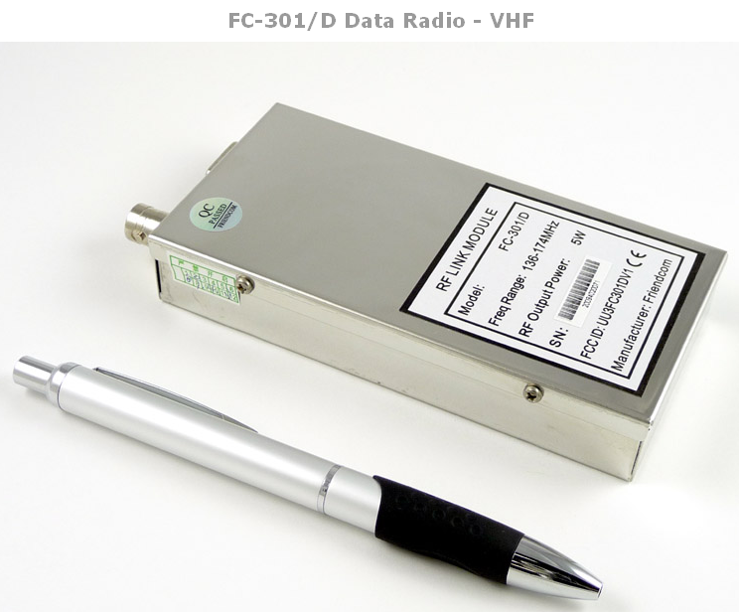
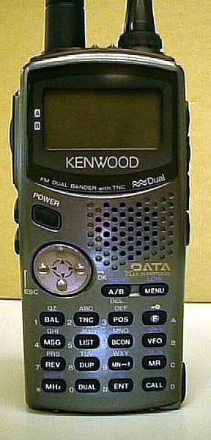
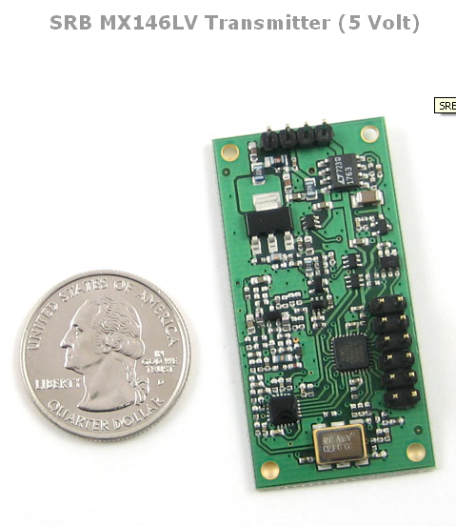
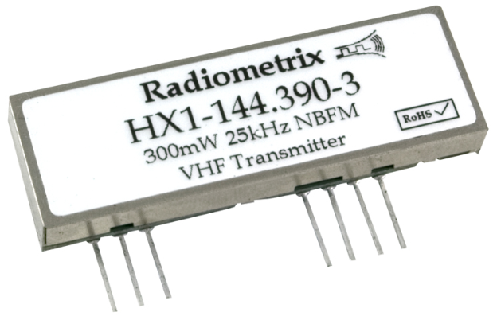
Radio Pictures
12/6/2011
Max Bezold
<number>

Slide 10
TNC
 | Byonics TinyTrak | Argent OpenTracker | OpenTracker code on 8051
Hardware | PIC | HC08 | SiLabs 8051
Voltage | 5V | 5V | 3.3V
D/A conversion method | PWM based, sine-wave lookup table | PWM based, sine-wave lookup table | PWM based, sine-wave lookup table
Configuration Interface | GUI/serial interface, 2 programmable profiles | GUI/serial interface, 2 programmable profiles | UART 8051programming interface
Source Code? | No | Yes | Yes
Reference design? | Yes | Yes | Yes
Unique Features | None | Analog telemetry packets, CW mode, onboard temperature and voltage packets, automatic profile selection | Same as open tracker
Cost (USD) | 18 | 8 | Free* (increased overhead in programming)
12/6/2011
Max Bezold
<number>

Slide 11
Microcontroller
 | SiLabs 8051F120 | Si1000 Wireless MCU
Supply Power | 3-3.6V, 50mA | 1.8-3.6V, 50mA nominal, 85mA transient power
Process Core | 8051 | 8051
Package | 100-TQFP | 42-QFN
ADC | 12-Bit/8-Bit | 10-Bit
PWM | 16-bit | 16-Bit
DAC | (2) 12-Bit | N/A
Timers | (4) 16 bit timers | (2) 16 bit timers
Memory | 8448 bytes RAM, 128 kB flash | 4352 bytes RAM, 64 kB flash
Digital Peripherals | SPI, I2C, UART | SPI, I2C, UART
Clock | 100 MHz | 25 MHz
I/O Ports | 64 | 22
Unique Features | FAT-FS already implemented | Includes UHF transceiver for remote sensor integration
Cost (USD) | $0 dollars (available as sample) | $0 dollars (available as sample)
12/6/2011
Max Bezold
<number>

Slide 12
GPS Modules for Ballooning
Research indicates that the SiRF Star III GPS chipset by CSR Inc. is compatible with ballooning requirements (operation altitude >60,000 feet)
This chipset is utilized in the Trimble Copernicus, Garmin, other GPS modules.
The firmware must be specially configured to allow Air Mode, if not preconfigured.
Not all GPS units come with the configuration software.
Software is available through chip manufacturer, but we must apply for access through the manufacturer.
Trimble does provide this software for their Sirf Star III based Copernicus GPS modules. It’s available free of charge on their website, and called Trimble Studio.
12/6/2011
Max Bezold
<number>

Slide 13
GPS Modules for balloons
Trimble Copernicus II
Argent Data Systems GT-320FW
Configurable to balloon mode using provided software
1.8cm x 1.8cm x 0.3cm
2.7-3.3V, 40mA.
NMEA format TTL output.
Other Trimble Copernicus modules have flown previously.
$20
Preconfigured to balloon mode.
3.4cm x 3.4cm x 1.0cm
3.7V-6V, 45mA.
NMEA format TTL or RS232 output
Based on Prolific GPS chipset
$38
12/6/2011
Max Bezold
<number>

Slide 14
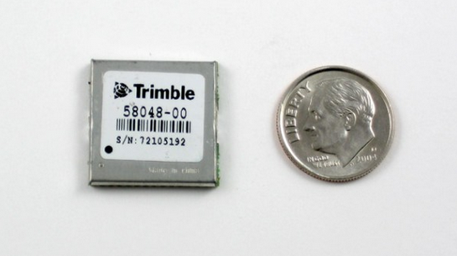
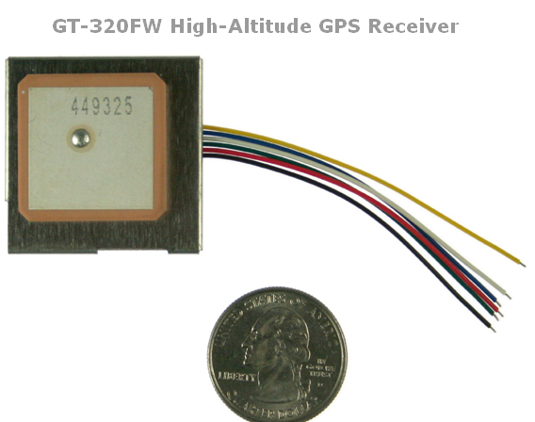
GPS Pics
12/6/2011
Max Bezold
<number>

Slide 15
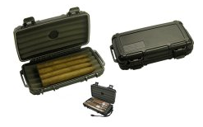
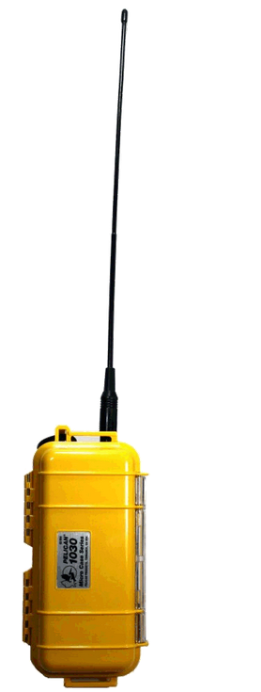
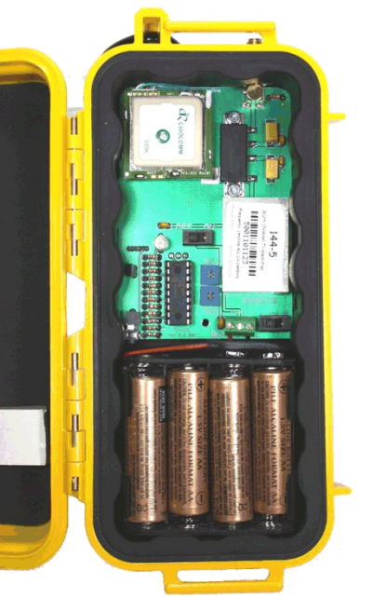
Robustness Requirement: the throw it down the stairs and survive requirement
Waterproof→Hermetically sealed box, with O-ring seals around openings
Shockproof→Plastic construction, rubber standoffs for shock absorption between enclosure and PCB
Pass through for GPS and radio coax (drill hole, insert coax extension, seal with silicone)
Final design determined by component selection
12/6/2011
Max Bezold
<number>

Slide 16
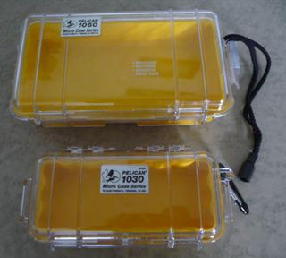
Dream Case
-Latching o-ring sealed enclosure
-Clear lid to view LED indicators.
-Drilled holes with pass through for coax connectors sealed with silicone,
-PCB mounted to enclosure via really squishy rubber standoffs for shock absorption
Pelican 1030?
Big Enough?
3D print something?
12/6/2011
Max Bezold
<number>

Slide 17
Addendum
Outcome of PDR:
-Begin more detailed trade study between SRB and HX-1, either one looks acceptable. (Going to choose SRB due to the frequency agility)
-Transceiver ability not necessary at this time.
-For TNC, design the board with Argent TNC OpenTracker chip onboard, but add jumpers and traces so that we can eliminate the chip in the future if we get the OpenTracker code to run on the 8051. (Add the appropriate passive components from the OpenTracker reference design to board to allow 8051 to be the TNC)
-Chose an 8051F120 as processor.
-Use Trimble Copernicus GPS.
-Use 1030 Pelican cases.
12/6/2011
Max Bezold
<number>

Slide 18
Suppliers for Equipment
Microcontrollers: available through as SI Labs as samples, or through mouser for purchase.
Radios: Radiometrix HX-1 available through Lemos International, lemosint.com; Friendcomm and SRB through Argent Data systems, argentdata.com; Kenwoods are available here in the lab.
TNC Chips: Byonics TinyTrak through Byonics, http://www.byonics.com, available as a replacement unit, a little harder to find to the website but it is there. OpenTracker TNC available through Argent Data Systems
TNC source code: http://www.argentdata.com/support/source-code.html
12/6/2011
Max Bezold
<number>

